Slide 1



Azure Functions Overview
Part 1
Alexander Klassanov
/in/alexander-klassanov/
https://github.com/klassanov/FunctionApps
Notes:
Open:
Visual Studio
Visual Studio Installer
Visual Studio Code
Azure Storage Explorer
Postman
Docker Desktop
Azure DevOps
Azure Portal
GitHub repo
Command Prompt in the directory for the Azure Core Tools demo

Slide 2
Contents
Introduction
Benefits
Use Cases
Bindings and Triggers
Development Options

Slide 3
What are the Azure Functions
FaaS : function as a service platform
Event-Driven Model Platform: running code in response to events
Serverless compute platform that helps you develop more efficiently using the programming language of your choice:
C#
Java
JavaScript
TypeScript
PowerShell
Python
Go
Functions Runtime Version Used: 4.x

Slide 4
What Is Serverless
Servers are abstracted away > Servers are managed for you, need to provide your code only
Per-second billing model, consumption-based cost-plan > Only pay when your code runs: no run, no cost
Automatic scaling in response to demand > Multiple servers meet the demand

Slide 5
Azure Functions Benefits
Fast development
Easy integration with different heterogeneous systems:
Azure Service Bus
Azure Queue Storage
Cosmos DB
Azure Event Hubs
Others
Cost reduction compared to a dedicated VM (in most cases)
Automatic scaling
Simpler, cheaper and more scalable compared to the traditional approach of creating an application and hosting it on a dedicated VM

Slide 6
Use Cases
Scheduled Tasks
Reminders and Notifications
Scalable Web API
Respond to DB changes
File processing
Messages and IoT data processing
Implement event-driven custom workflow
And more...
Notes:
Scheduled Tasks: backups and cleanups
Reminders and Notifications: send emails or sms
Scalable Web API: scalability out of the box
Respond to DB changes: run code when a change in a db happens
File processing: run code when a file is uploaded or changed in a blob storage
Messages and IoT data processing: collect and process data from IoT sources, easy integration with with different extenal systems such as Queue Storage, Service Bus, or Event Hubs
Implement event-driven custom workflow: meet the clients' specific needs

Slide 7
Bindings and Triggers
Input Binding: connect to a data source and read data from it
Output Binding: connect to a data destination and write data to it
Trigger: special type of input binding that causes the function to run
Bindings are connection code that you don't have to write
Binding Types Examples: Blob Storage, Azure Service Bus, Queues, Azure Cosmos DB, Azure Event Hubs, Custom Bindings, etc.
Notes:
Pass data to the function from a data source
Write data from the function to a data destination
A function can have only 1 input trigger

Slide 8
Development Options
Modes: On-Portal, Local
Languages: C#, Java, JavaScript, PowerShell, Python, TypeScript, Go
IDEs: Visual Studio, Visual Studio Code
Function App
set of functions
development language
common configuration
scale together
same runtime stack
service plan in Azure
single unit of deployment

Slide 9
Demo: On Portal Development
Azure Function created inside the Function App
Source Code
Triggers and Bindings
Security
Notes:
When you create an Azure Function app through the Azure portal, by default, it will create a storage account alongside it. This storage account is used by Azure Functions for various purposes, such as storing execution logs, function metadata, and other operational data. The storage account created alongside the Azure Function app is typically used for:
Azure Functions runtime data: This includes function logs, function execution state
Azure Functions triggers and bindings: Some triggers and bindings, such as Azure Blob Storage triggers or Azure Queue Storage bindings, may require a storage account to store data or metadata related to the trigger or binding.
Azure Functions deployment: The storage account might also be used for storing deployment artifacts or temporary files during the deployment process.

Slide 10
Local Development in Visual Studio and C#
.NET 6 +
Azure Functions Core Tools
Azure development workload included in the VS installation -> VS installer
Azurite emulator for local Azure Storage development (for VS version < 2022)
IDE Azure Functions plugins/extensions (optional)
Notes:
Functions-related features in Visual Studio and the Azure Functions extension for Visual Studio Code are built on top of Core Tools

Slide 11
Demo: Local Development in Visual Studio
FunctionApp.HTTP project
FunctionApp.Timer project
Referenced Packages
Configuration Files
Unit Tests
Docker

Slide 12
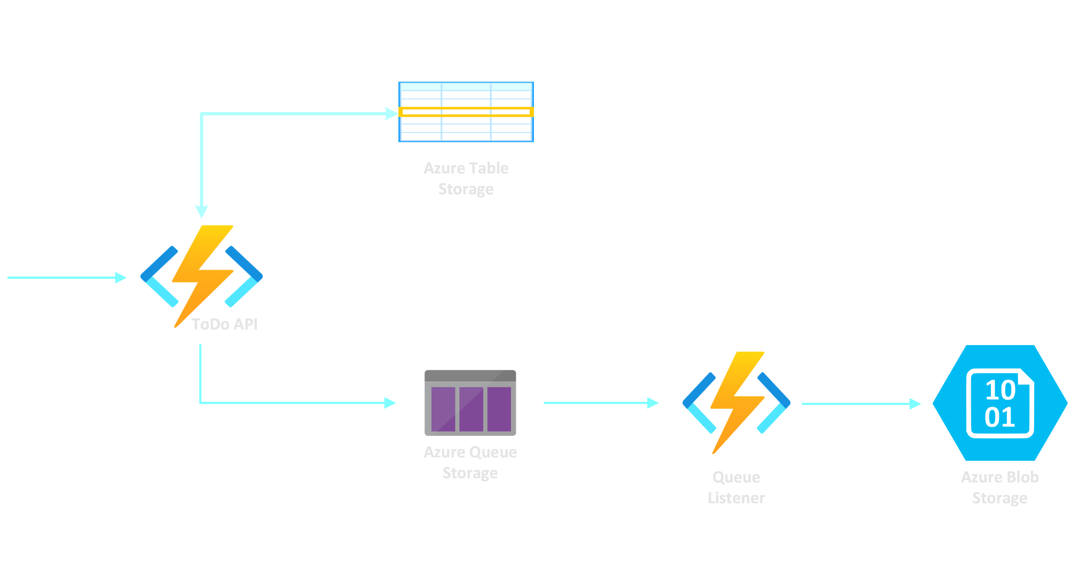
Demo: FunctionApp.Queue.RestAPI project

Slide 13
Demo: Local Development in VS Code
Requirements:
NET 6 +
Node.js
Azure Functions Core Tools
Azure Functions Extension

Slide 14
Demo: Local Development with Azure Functions Core Tools
Azure Functions Core Tools CLI Demo
func
func init MyProjFolder
func new
func start
Notes:
func init MyProjFolder
func new

Slide 15
References
https://azure.microsoft.com/
https://learn.microsoft.com/en-us/azure/azure-functions/
https://app.pluralsight.com/library/courses/microsoft-azure-serverless-functions-create/table-of-contents

Slide 16
Thanks for your time and attention!

